Slide 1
Ethics In Clinical Studies And Research

Slide 2
Introduction
In medical research, it is important to adhere to the laid down protocols throughout. Medical research involves clinical trials –carrying out experiments to determine the effects of drugs on human beings.
There are 4 phases of clinical trials:
Phase I –Evaluates the pharmacology and safety of the drug.
Phase II –Evaluates the therapeutic exploration and range of therapeutic dose.
Phase III –To confirm the therapeutic effects and comparison to other drugs.
Phase IV – Post-marketing surveillance and studies
Notes:
Ethics are moral principles. They play a key role in protection of human subjects in a research. There are numerous people involved in medical study. The best example of medical study/research is clinical trials. In phase I -20 to 80 individuals, phase II -100 to 300 individuals, phase III –about 3000 individuals and in phase IV the number is even larger. All the human subjects are protected by ethical values. During all these phases, human subjects are recruited. It is necessary to make sure that they are maximally protected and in case of any effects, they are entitled to compensation.
It is required, all researchers must uphold all the ethics when carrying out their studies. Ethics are moral values that guide professions’ behavior. In the medical field, they are critical guidelines that must be considered in every decision making. (Abramowicz & Szafarz., 2020)

Slide 3
Ethics In Medical And Clinical Research - Beneficence
Beneficence means that whatever you do is to benefit the participant. The researcher is expected to act in the best interest of his or her human subject.
In the case of a community, the researcher should always have assessed the benefit that the community will derive from the research been done on them.
These may include the incentives that will be awarded to the participants.
This may include developments to counteract the negative effects of the study in the area.
Notes:
Beneficence is an act of philanthropy. Simply describes acts that are charitable and kind to the other party, in this case, the human subject in the research. This behavior is encouraged throughout the research process. For example, in studies that involves obtaining a crude medicine from a plant –sometimes this may require the researcher to destroy the whole plant to extract the crude drug. Having this in mind, the researcher should have developed a program to sustain the particular plant in the region.
the researcher should have developed a program to sustain the particular plant in the region.
This is beneficial to the community as such programs develop sustainable ecosystems in the area.
Beneficence in research is also evident when the research brings some development in the particular region where the study is being conducted. (Adashi et al., 2019)

Slide 4
Ethics In Medical And Clinical Research –Non-malfeasance
Non-malfeasance –this is a value that every medical practitioner must uphold. Non-malfeasance means that one will do harm to the subject intentionally.
Sometimes drugs may do harm to the individuals. For example, during the first phase of clinical trials.
It is recommended that they have a good health insurance cover to cater for management and for any adverse drug effects that may require treatment.
Notes:
Non-malfeasance means that the researcher will refrain from all kinds of wrongdoing. It is a principle that dictates that you will not wrong any of your human subjects throughout the study. In this case, all the human subjects should have an insurance cover.
The kind of insurance to recommended varies with the kind of research. Risk assessment must be carefully done so that all precautions are taken at the most appropriate time –before the study begins, during the study or after the study.
After risk assessment, all the participants should be notified and all the necessary information disclosed to them before they sign up for the consent form (DeJonckheere & Vaughn., 2019).

Slide 5
Ethics In Medical And Clinical Research –Autonomy And Privacy
Autonomy
Autonomy refers to freedom to make decisions independently especially when the individual is an adult. Before the individual makes the decision she or should be well informed on the merits and demerits of participating in the study.
Privacy
Privacy is important in every medical field. All participates information should not be disclosed to other people. Participants’ data should not leak out especially when it includes the subjects’ personal information.
Notes:
The participants have the right to accept or refuse to participate in the research or study. No one should be forced into the study. All human subjects are required to make an informed and uncoerced decision. Participants should be notified of all the risk, necessary precaution and any other relevant data before they are asked to make their decisions. If the participants are not willing to participate they are free to decline the offer.
Protecting the community includes respecting the decisions made by the individuals. As part of protecting the individuals, training before the study must done thorought.
Confidentiality should also be maintained all through (Bigby et al., 2019).

Slide 6
Ethics In Medical And Clinical Research –Honesty And Dignity
          Honesty
Honesty refers to the principle of always speaking the truth. The researcher is expected to be frank and open.
Veracity is greatly valued in the medical field and research.
          Dignity
The researcher should never lower the participants dignity or vice versa. Every participant should be highly esteemed because without the participants there is no clinical research that can be done.
Notes:
Throughout the research, all participants are expected to be truthful. Researcher and participants should respect each other. Honesty also means the researcher should disclose all information to the participants and not hiding true information with worries that the subjects may refuse to participate in the study. For example, if the research is on a particular drug, let the subjects know any adverse drug effects expected.
This will always promote dignity for each other (Jerjes et al., 2018)
Sensitive topics should be handled with care so that no one is stigmatized based on their status such as HIV/AIDS and matters that are sexual.
The research should also be conducted in way such that none of the activities is dehumanizing or demoralizing.

Slide 7
Ethics In Medical And Clinical Research –Justice
Justice refers to equal treatment of people in the research process. No one should be denied the chance to participate in the study.
The opportunities to participate in the study should be distributed on a fair basis.
There should be no bias or preferences to any side or towards a certain individual or groups of individuals.
Once the study has started all the subjects should be treated equally –without favoring anyone.
Notes:
Fairness should prevail throughout the research. Otherwise the researcher will end up with conflicts with the subjects. In simple terms, no one should be undermined due to his or her gender, disability, race, religion, level of education or on any other basis.
Discrimination also lowers the dignity of the oppressed subjects. They feel as if they are inferior. In case they are physically strong and aggressive they may get to a point of attacking those individuals that are favored in the study.
There should be equal distribution of the study resources and all incentives distributed among all participants without favorism. Insurance cover should be allocated fairly (Martin et al,. 2019).

Slide 8
Creating An Excellent Consent Form
A consent form should be clear and straight to the point. Following are some of the key guidelines that one can follow in order to come up with a good credible consent form.
Clearly state that the participation is voluntary. It should be clear that autonomy is a guarantee.
Include a research summary in the consent form. State the key objectives of the study. The study method to be used and the duration of study.
Notes:
There should be no any ambiguous or vague question. One should use simple language –that everyone participating in the research can understand. The method of study should list main activities and procedures to be followed during the research. Write down the risks that one can predict that may be associated with the study.
Here, one should also include any discomfort that may be caused to the participant during the study. State the expected benefits and results of the study. This also comprises of any incentives or compensations to be given. If there will be rewards for good participation.
Finally list any other alternative methods or studies that the participate can engage in in case they are not comfortable with your method of choice or in case your method of choice fails.

Slide 9
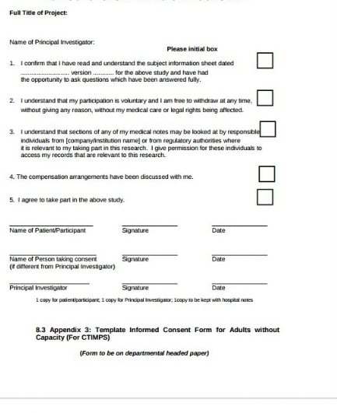
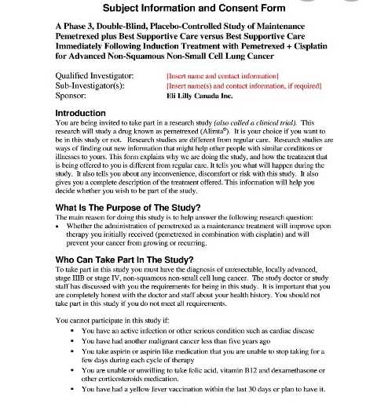
Consent Form
Notes:
In this sample consent form, there is a brief description of the study as an introduction. The purpose of study –statement of the key aims and objectives of the study. In a good consent form, the researchers should include the persons who can take part in the study and why they prefer that kind group of people. The researchers are also expected to state reasons why one cannot take part in the study. For example, in a study where the researcher wants to test live attenuated vaccine, immune-compromised subjects should not be included in the first phase trials. It is good to also enquire about any other underlying conditions in a clinical research. On the other side is a questionnaire that the subject fills in. If agrees, then, the subject should sign in the given space.

Slide 10
Summary
Ethics are key in protecting participants of particular clinical study.
Among the most essential ethics are autonomy, beneficence, non-malfeasance, justice, honesty, privacy and dignity.
With strict adherence to ethic, there is conducive environment and researches yield more accurate results.
Notes:
Ethic also ensure that the research upholds the social and moral values of the society where the study is been done.
It is important to generate a good consent form to have the best participation of all the subjects. A good consent form informs the subjects on what is expected from them. Privacy and confidentiality allows the subjects to be free and open to the researcher while beneficence and non-malfeasance ensures that the benefits of the research are evident to the community.
The consent form must always be clear and informative to the subject. All these contribute to the success of the research.

Slide 11
References
Abramowicz, M., & Szafarz, A. (2020). Ethics of RCTS. Randomized Control Trials in the Field of Development: A Critical Perspective, 280.
Adashi, E. Y., Walters, L. B., & Menikoff, J. A. (2018). The Belmont report at 40: Reckoning with time. American Journal of Public Health, 108(10), 1345-1348.
Bigby, C., Whiteside, M., & Douglas, J. (2019). Providing support for decision making to adults with intellectual disability: Perspectives of family members and workers in disability support services. Journal of Intellectual & Developmental Disability, 44(4), 396-409.
DeJonckheere, M., & Vaughn, L. M. (2019). Semistructured interviewing in primary care research: a balance of relationship and rigour. Family Medicine and Community Health, 7(2).
Jerjes, W., Hamoudi, R., & Hopper, C. (Eds.). (2018). The Power of Research: Best Practices and Principles in Research Integrity and Publication Ethics. Kugler Publications.
Martin, N. A., Kalbarczyk, A., Vgourney, E., Reich, A., Hansoti, B., Kambugu, A., ... & Castelnuovo, B. (2019). Bending the arc towards equitable partnerships in global health and applied training. Annals of global health, 85(1).
Notes:
Any questions?

